Slide 1
Creating windows ec2 instance
→by Team aws era

Slide 2
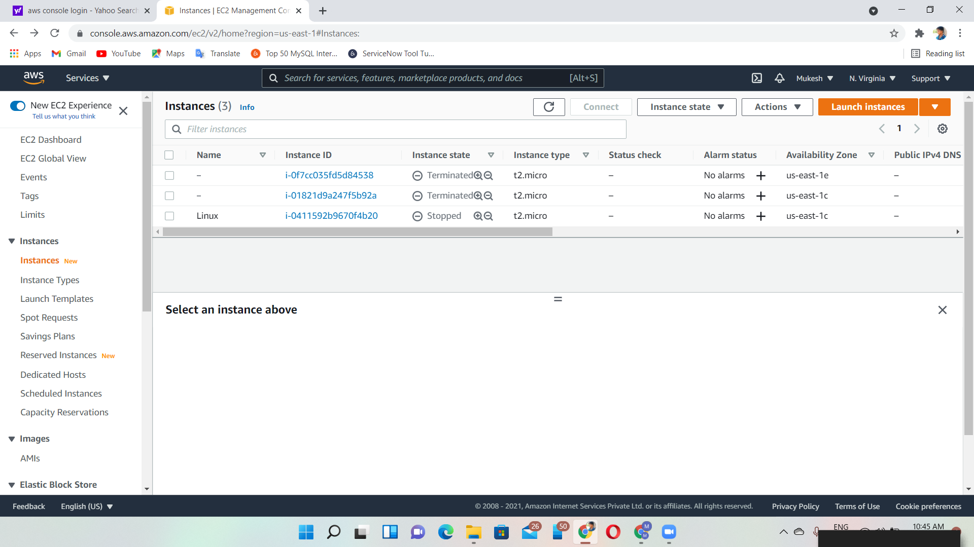
Installing packages in windows
Step 1:click launch instance

Slide 3
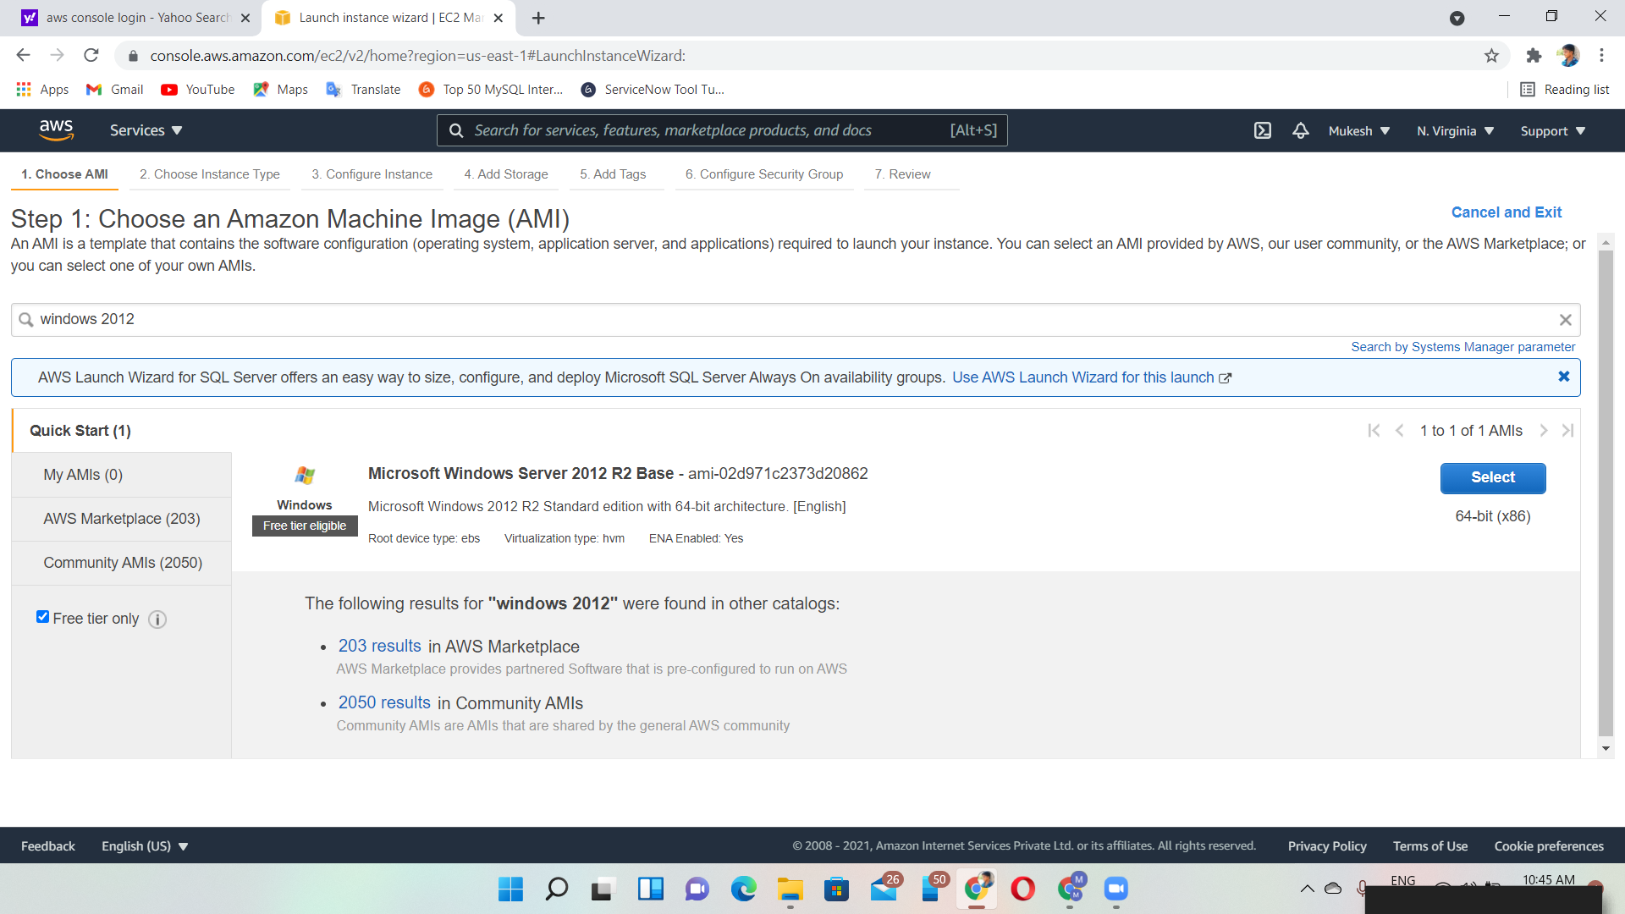
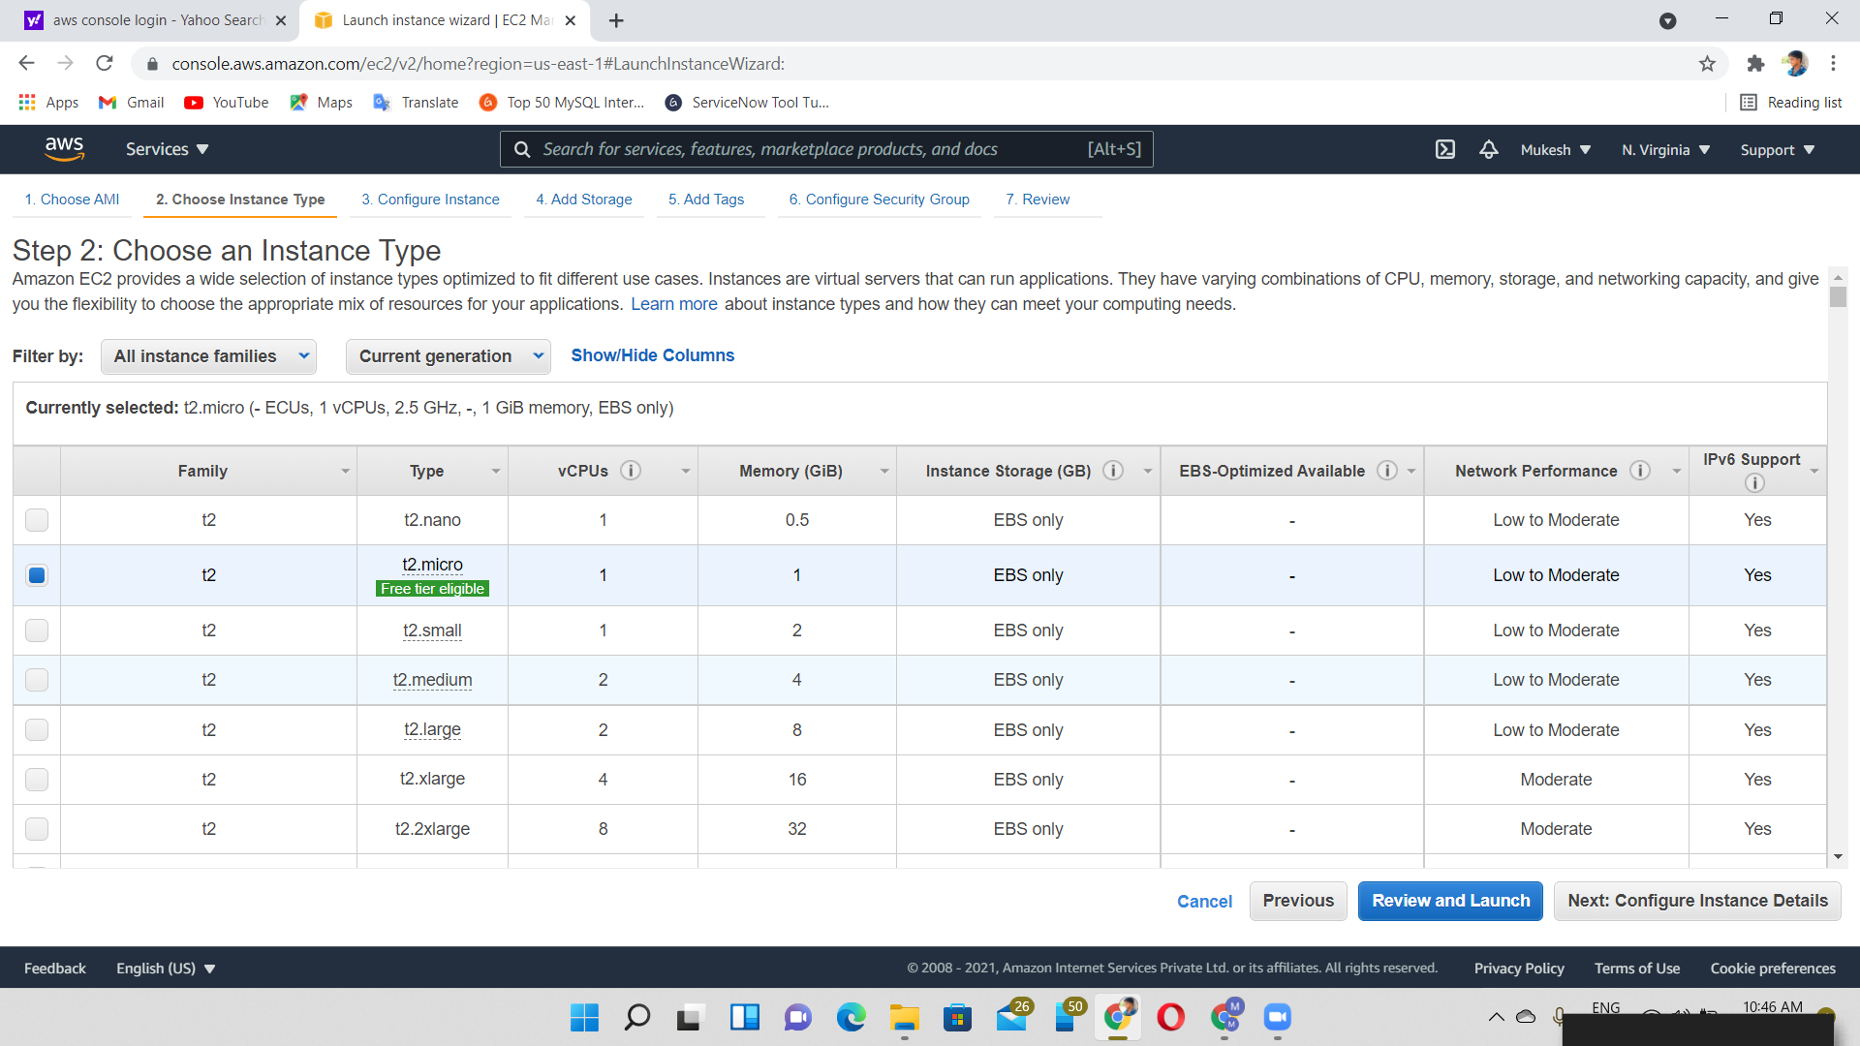
Step 2: choose the os(image) we want
STEP 3: Choose the instance type & click the t2.micro(free tier)

Slide 4
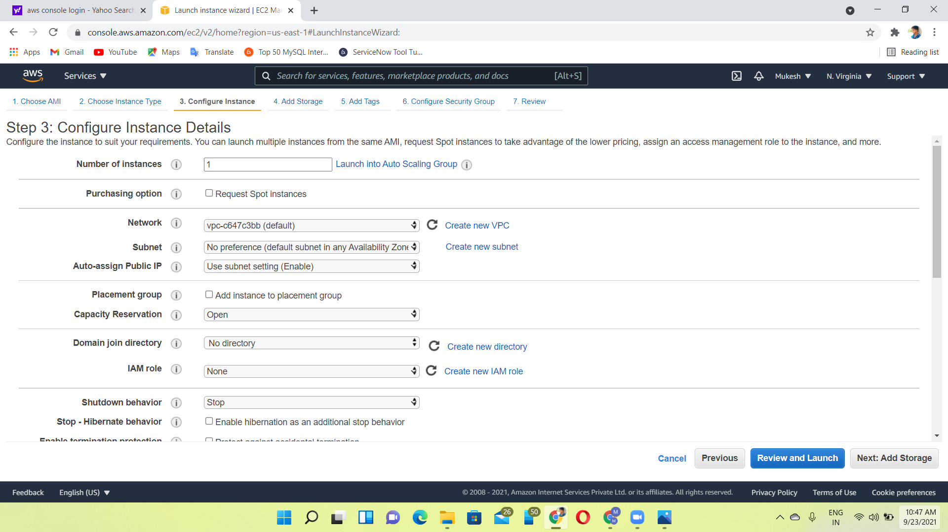
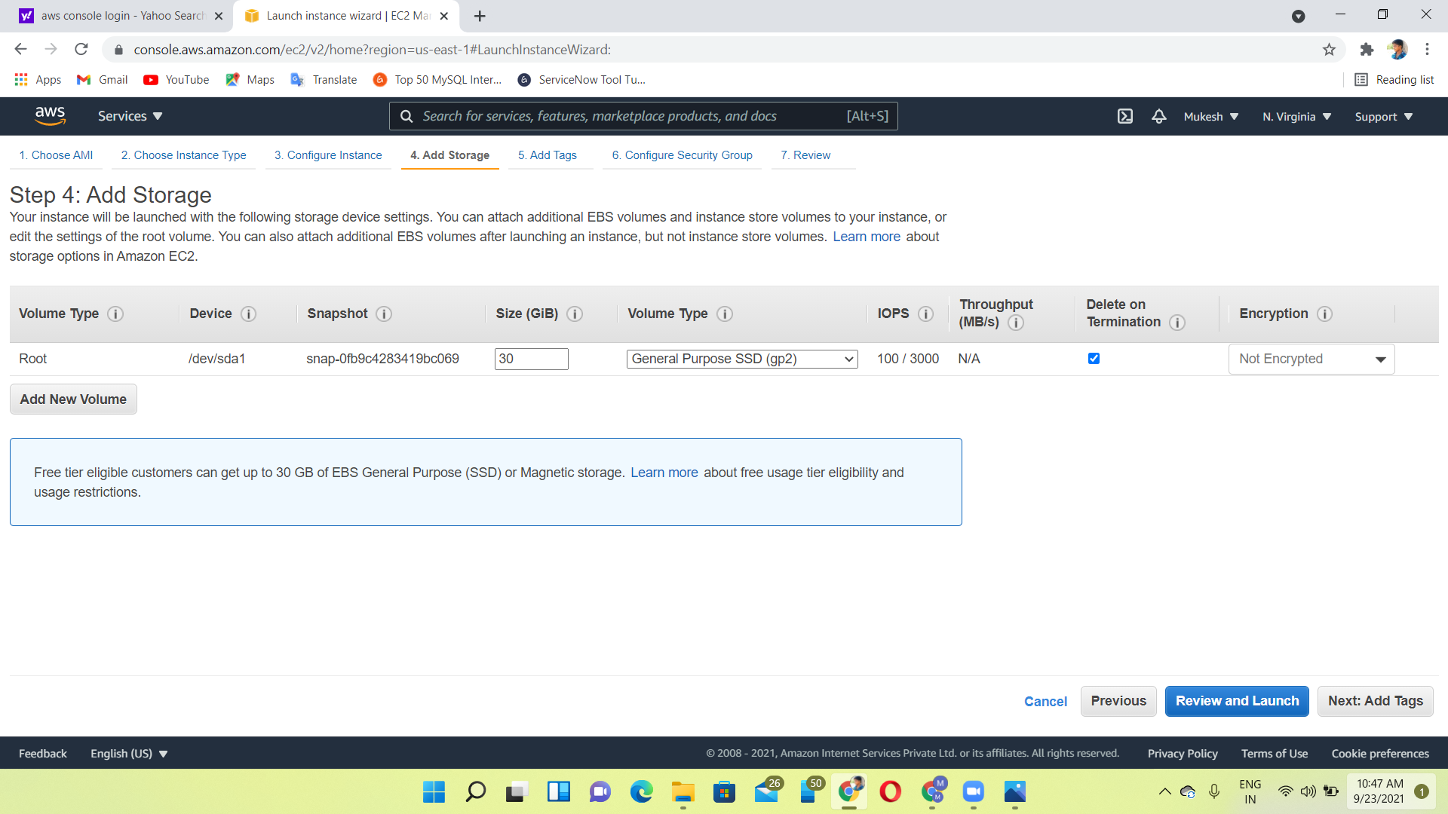
Step 4: Configure instance details
Step 5: Add storage

Slide 5
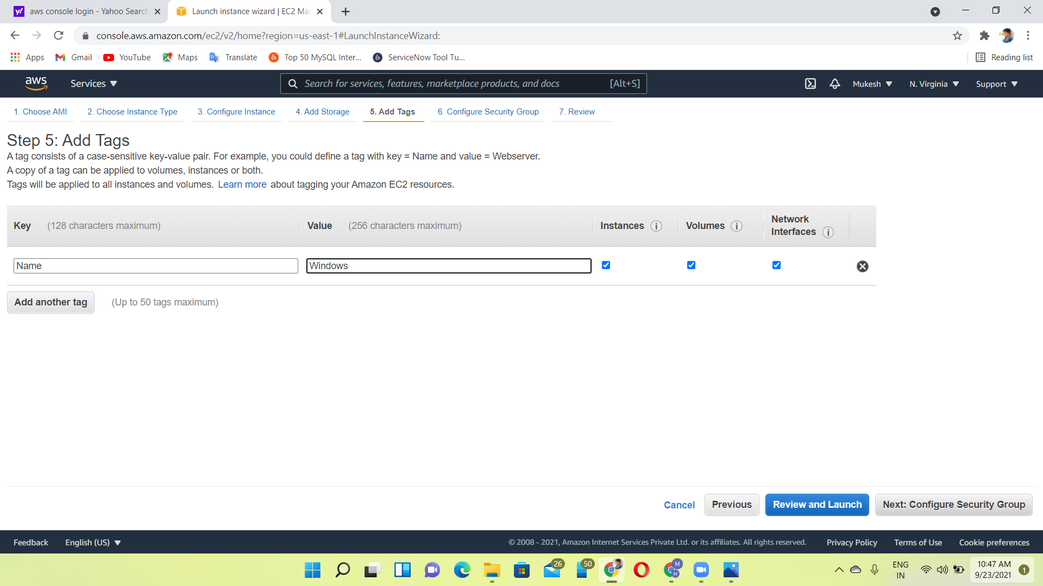
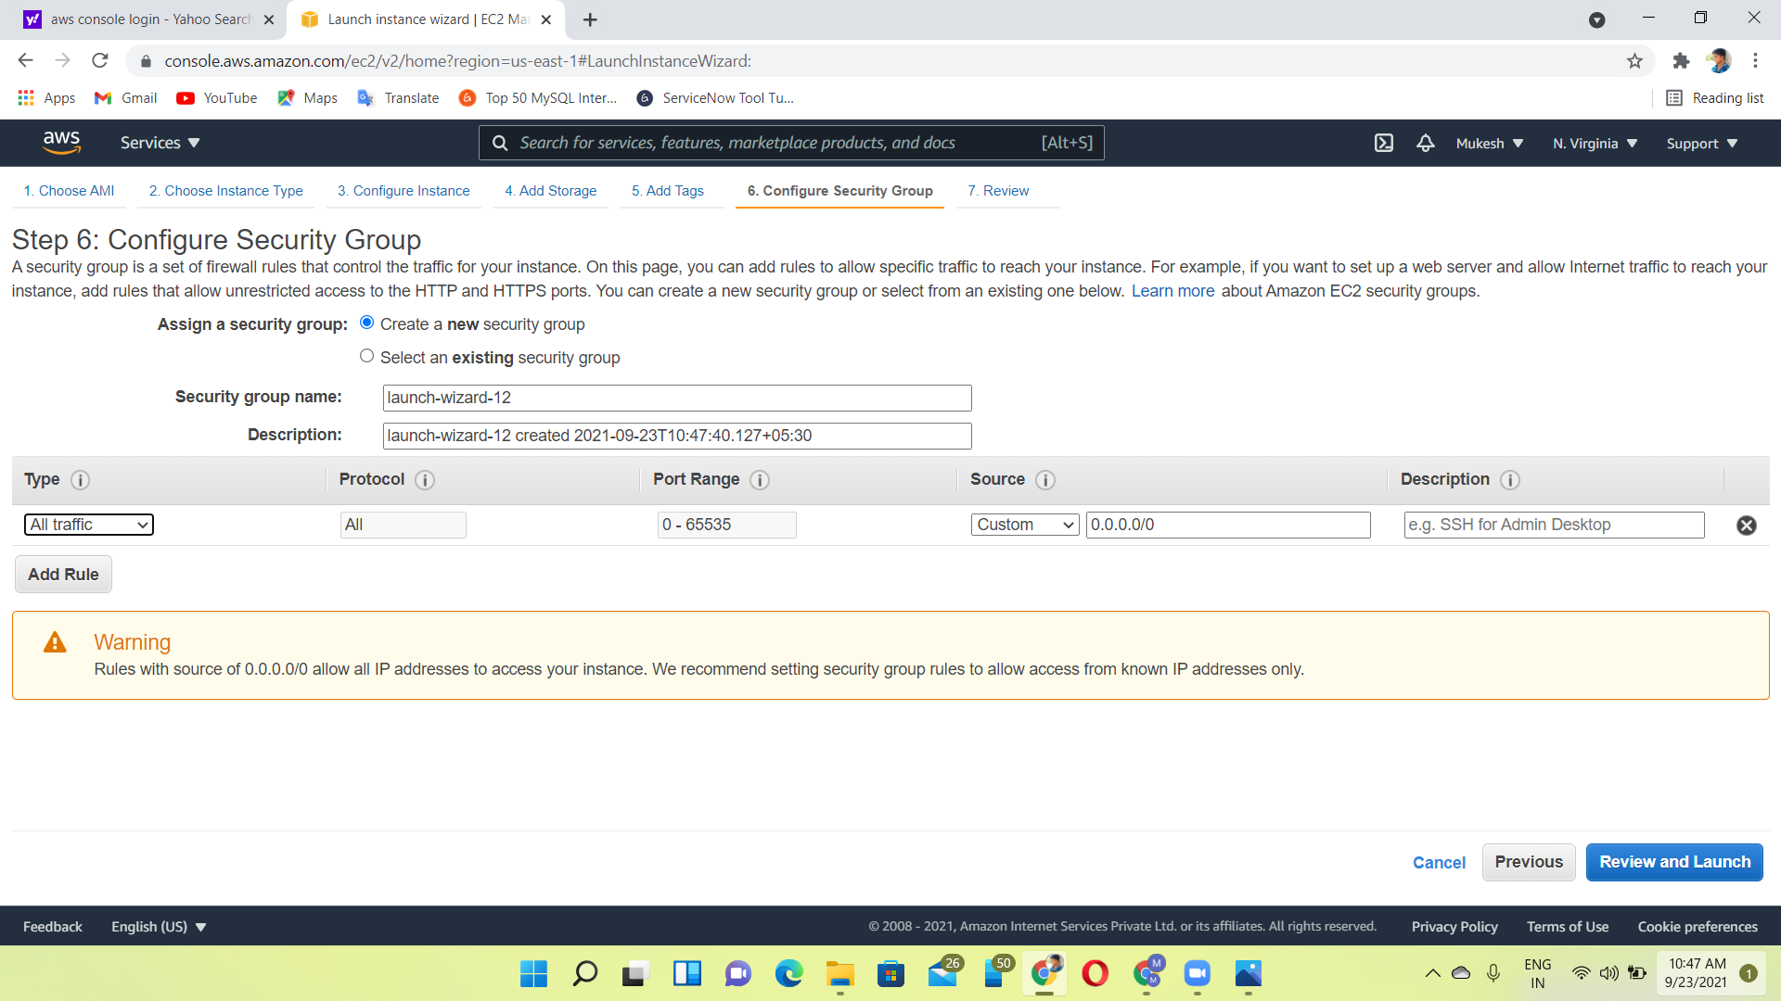
Step 6:add tags
Step 7:Configure security groups

Slide 6
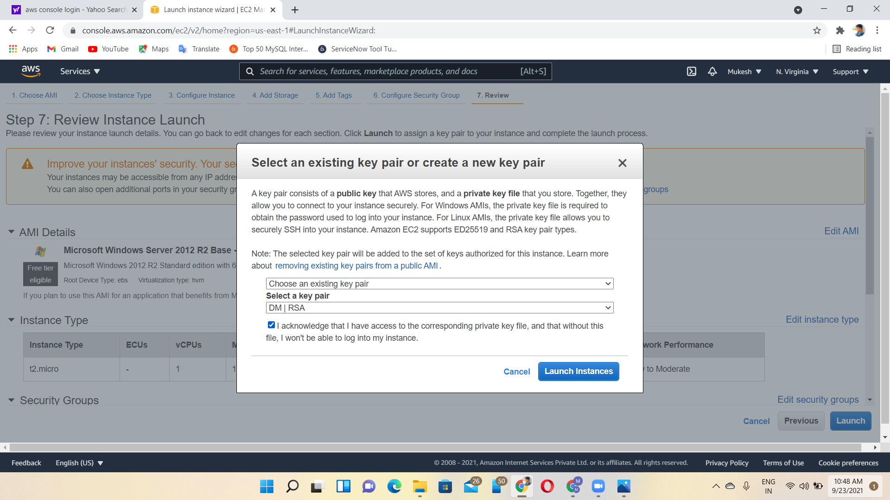
Step 8:select the key pair & launch the instances

Slide 7
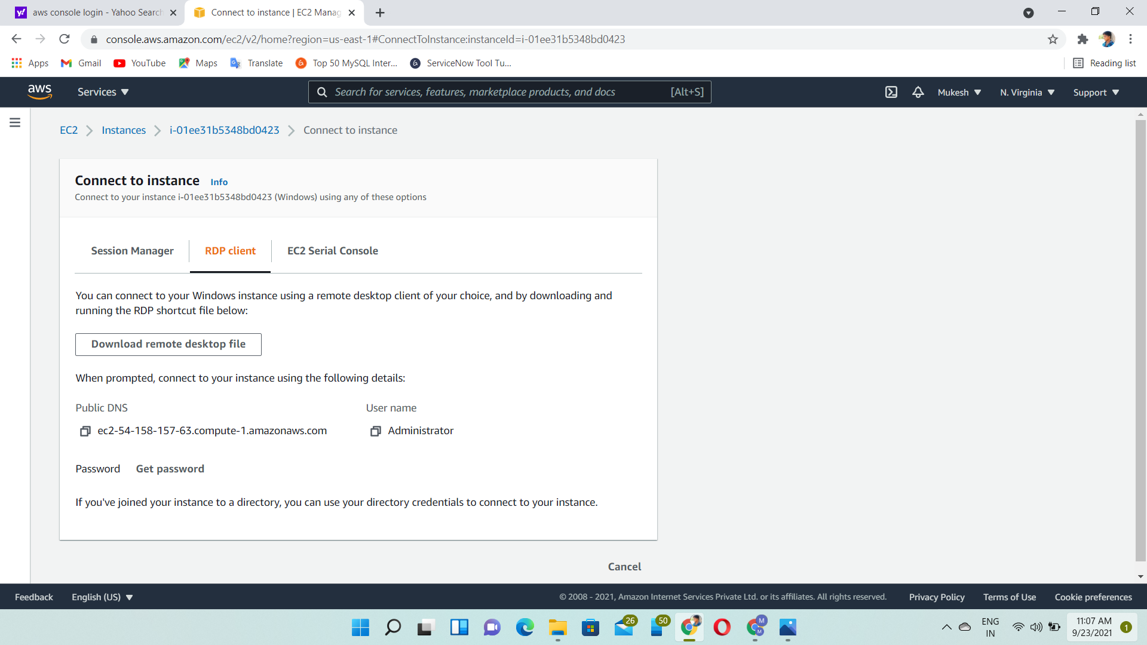
How to connect windows instance
Click the windows VM and then, click the connect, RDP client
we can connect to our windows instance using a remote desktop client and by downloading the remote desktop file.

Slide 8
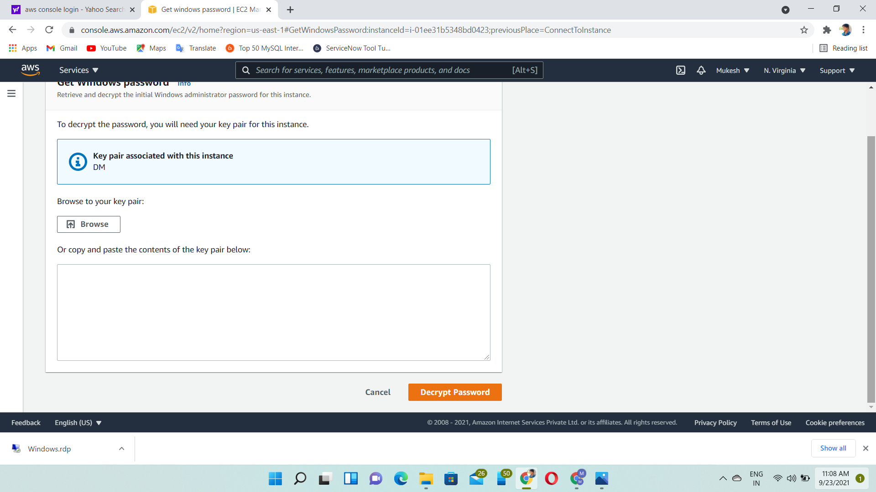
How to get the rdp login password

Slide 9
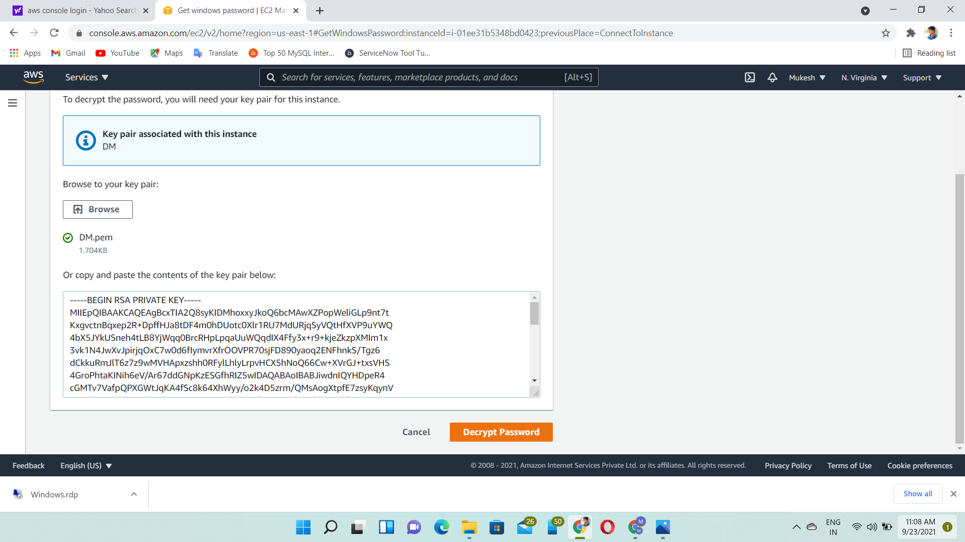
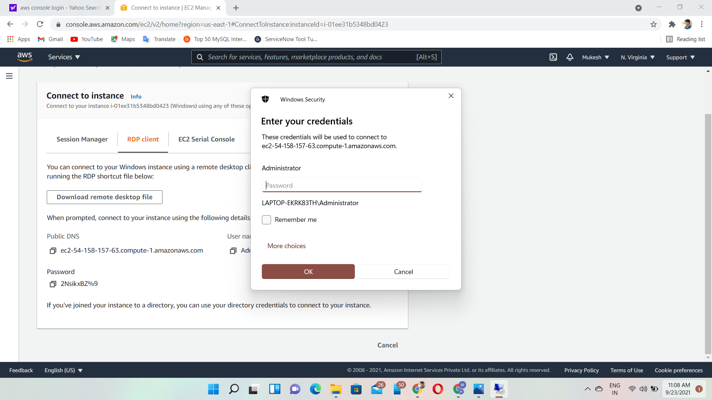
How to get the rdp login password

Slide 10
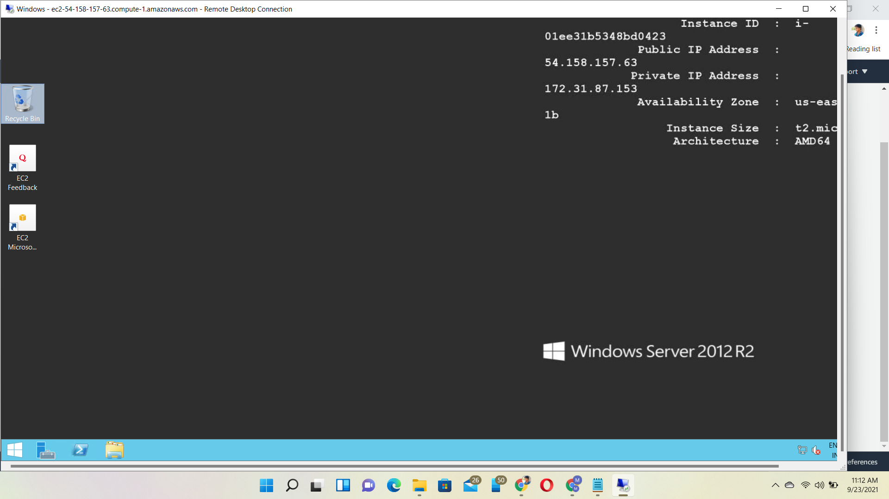
Entering the windows machine

Slide 11
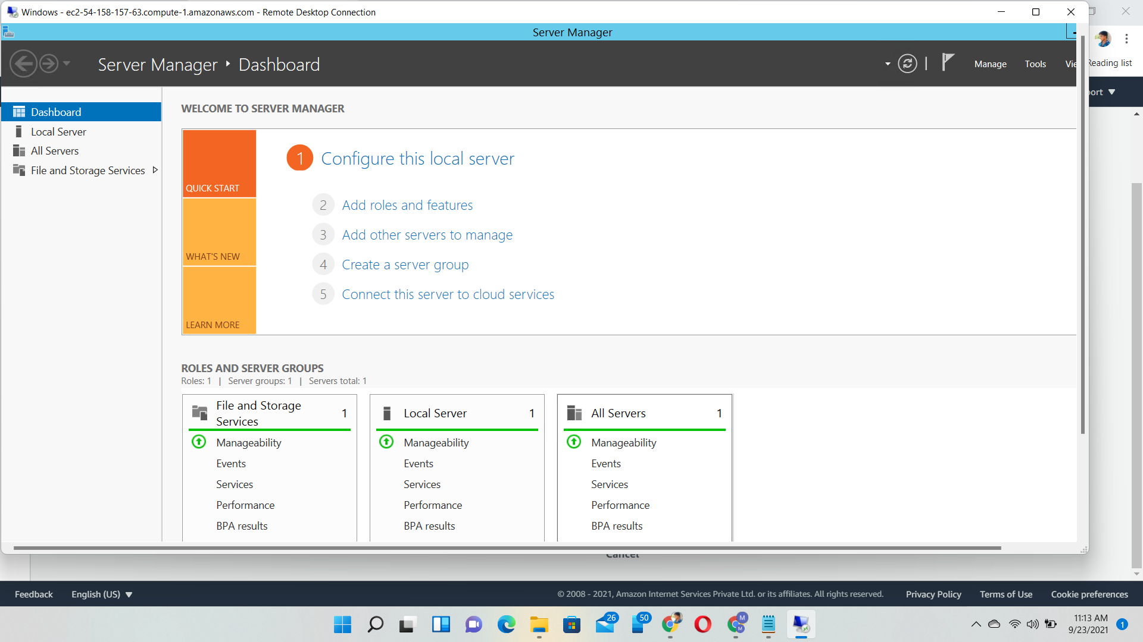
Service Manager dashboard
Then, click the add roles & features

Slide 12
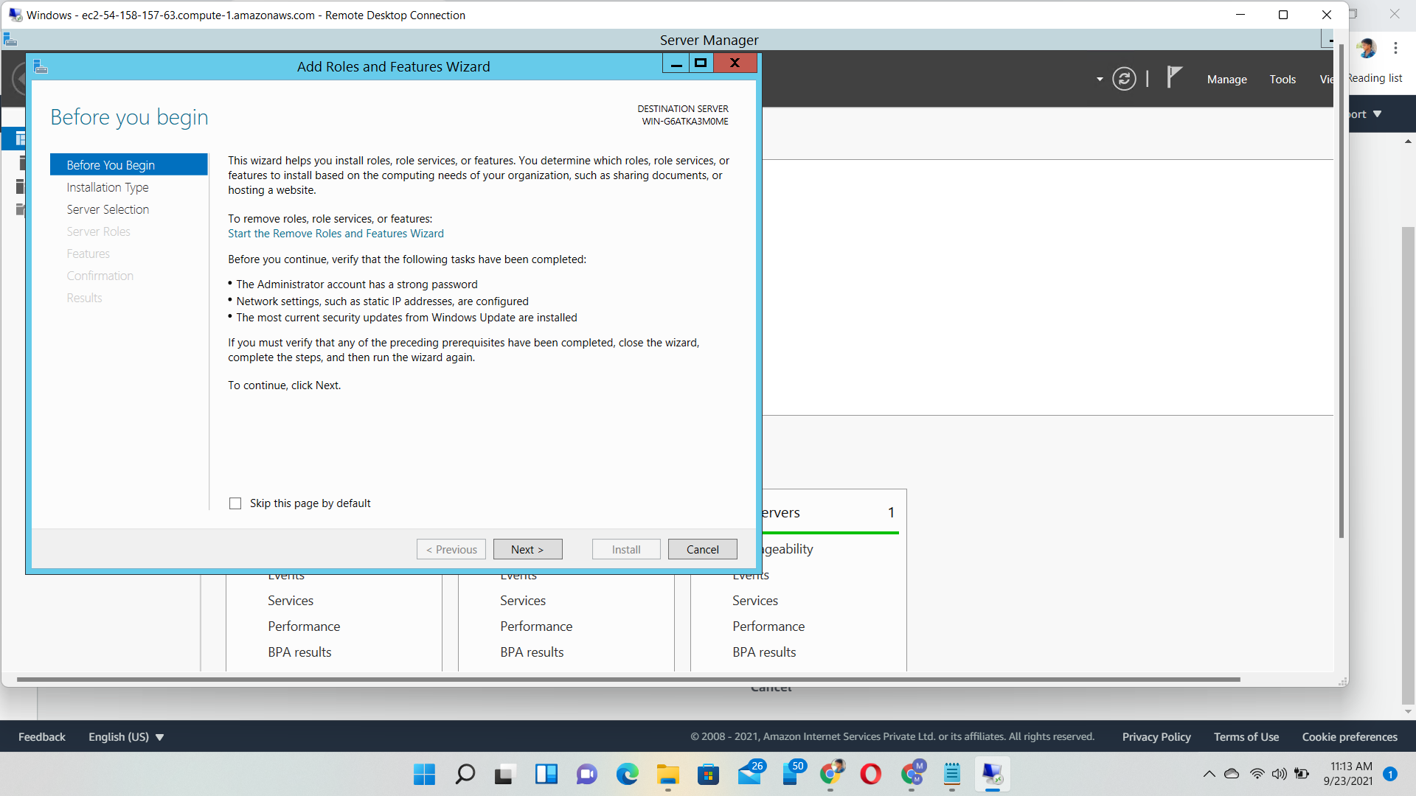
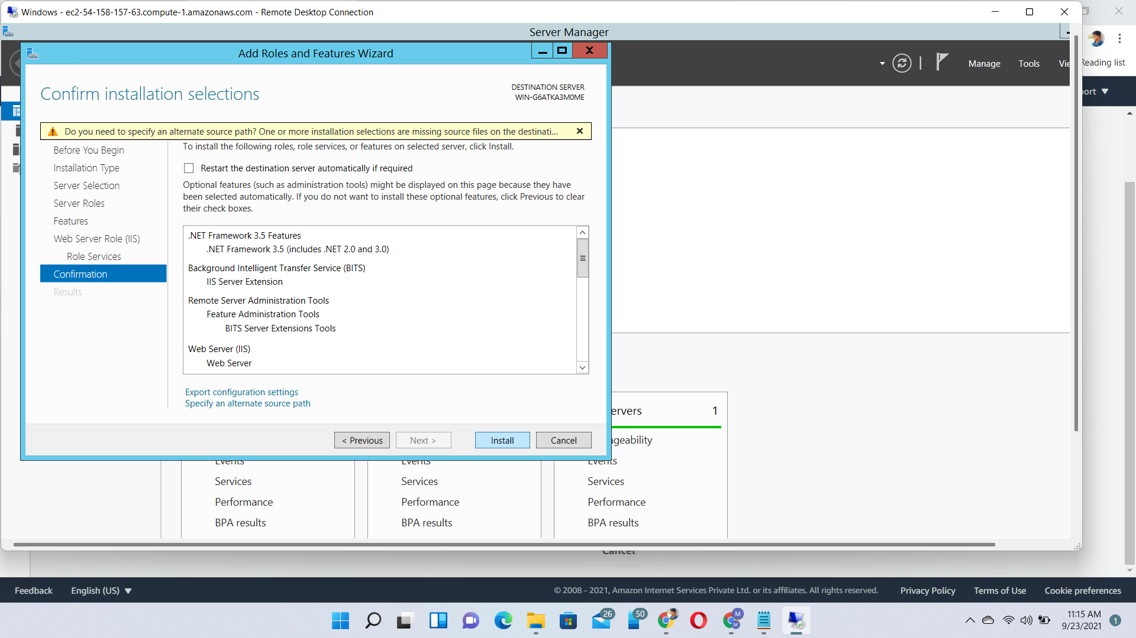
Installing internet information services

Slide 13
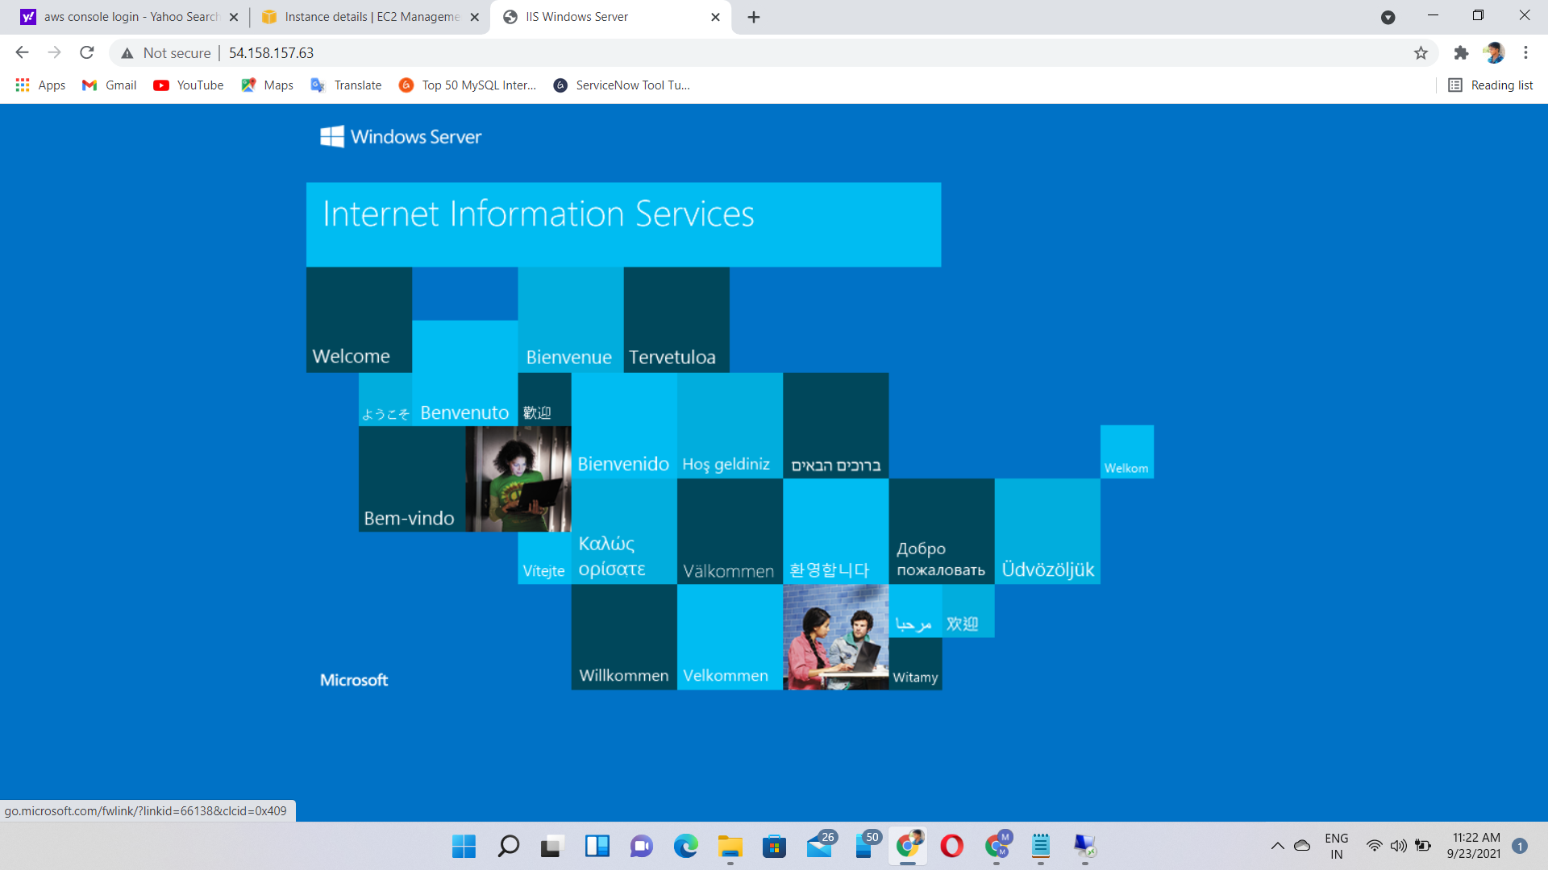
Output of the internet information services

Slide 14
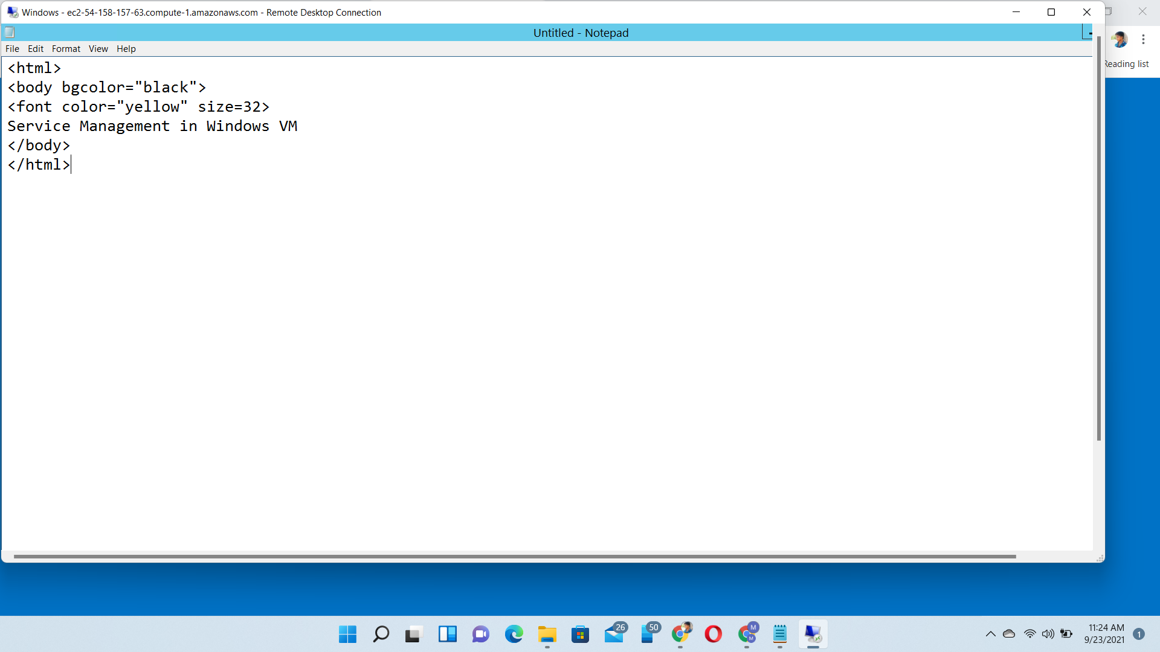
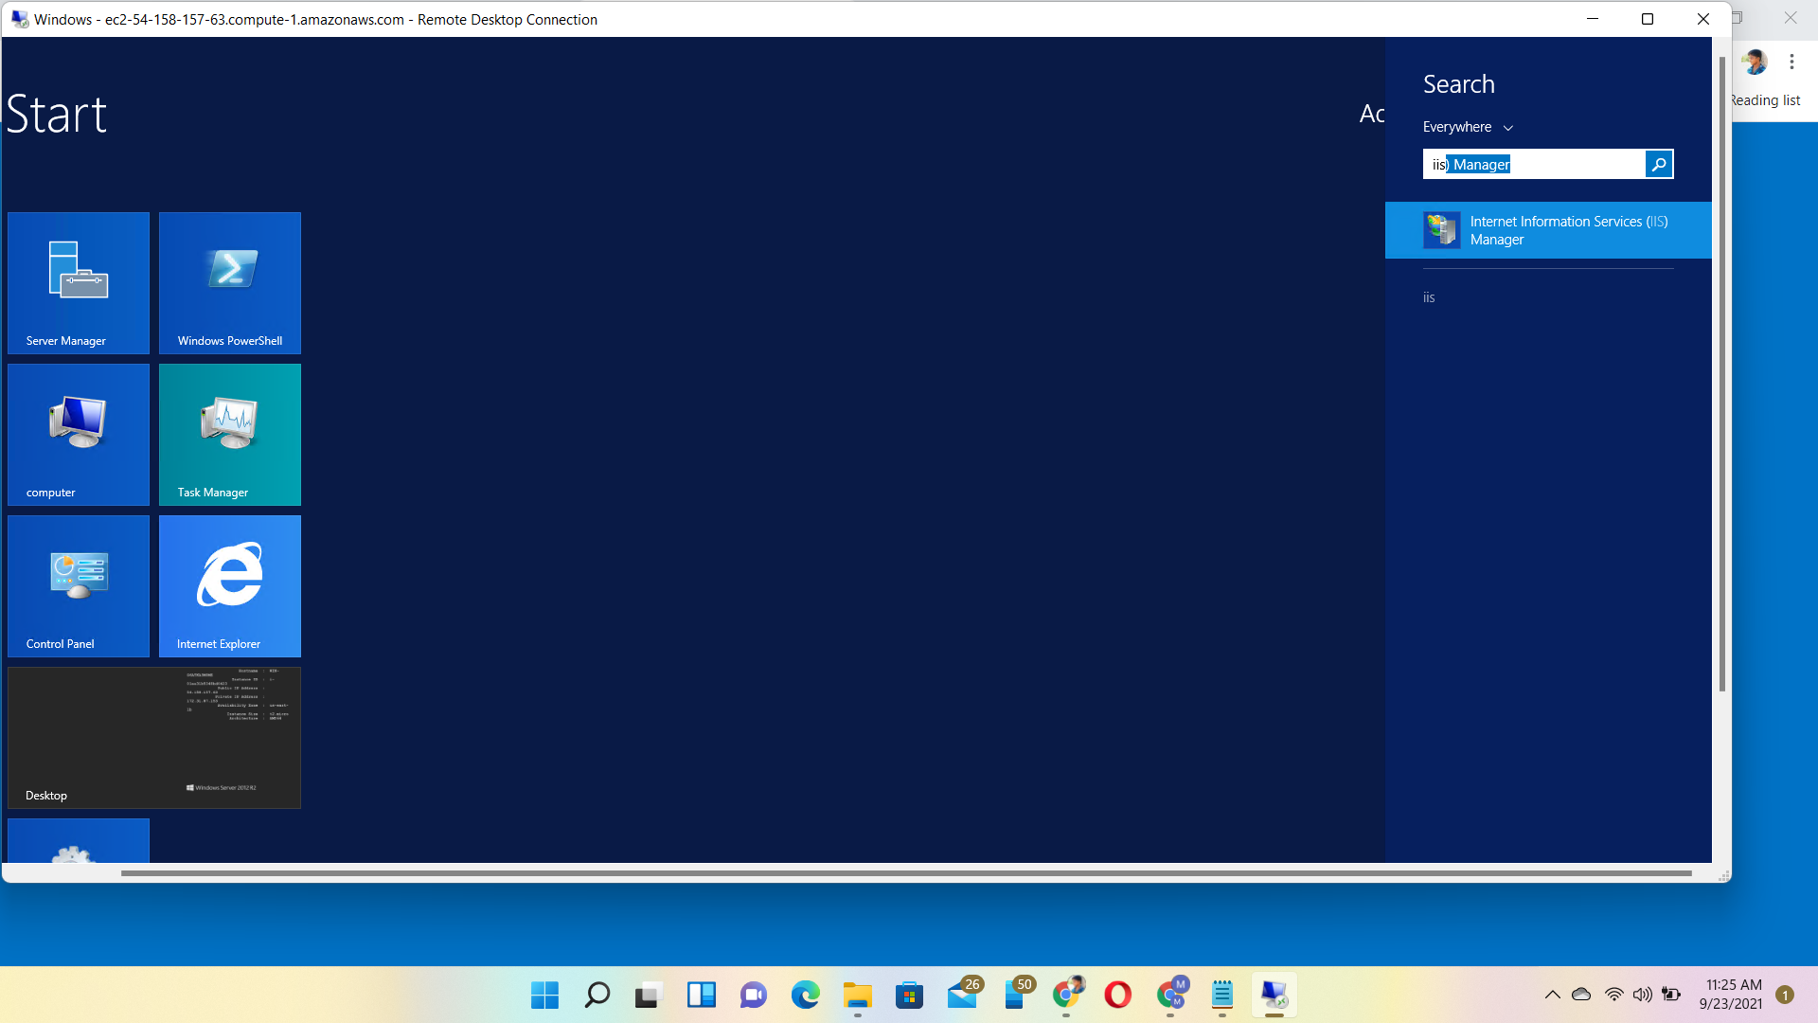
Create the aws.html file in notepad

Slide 15
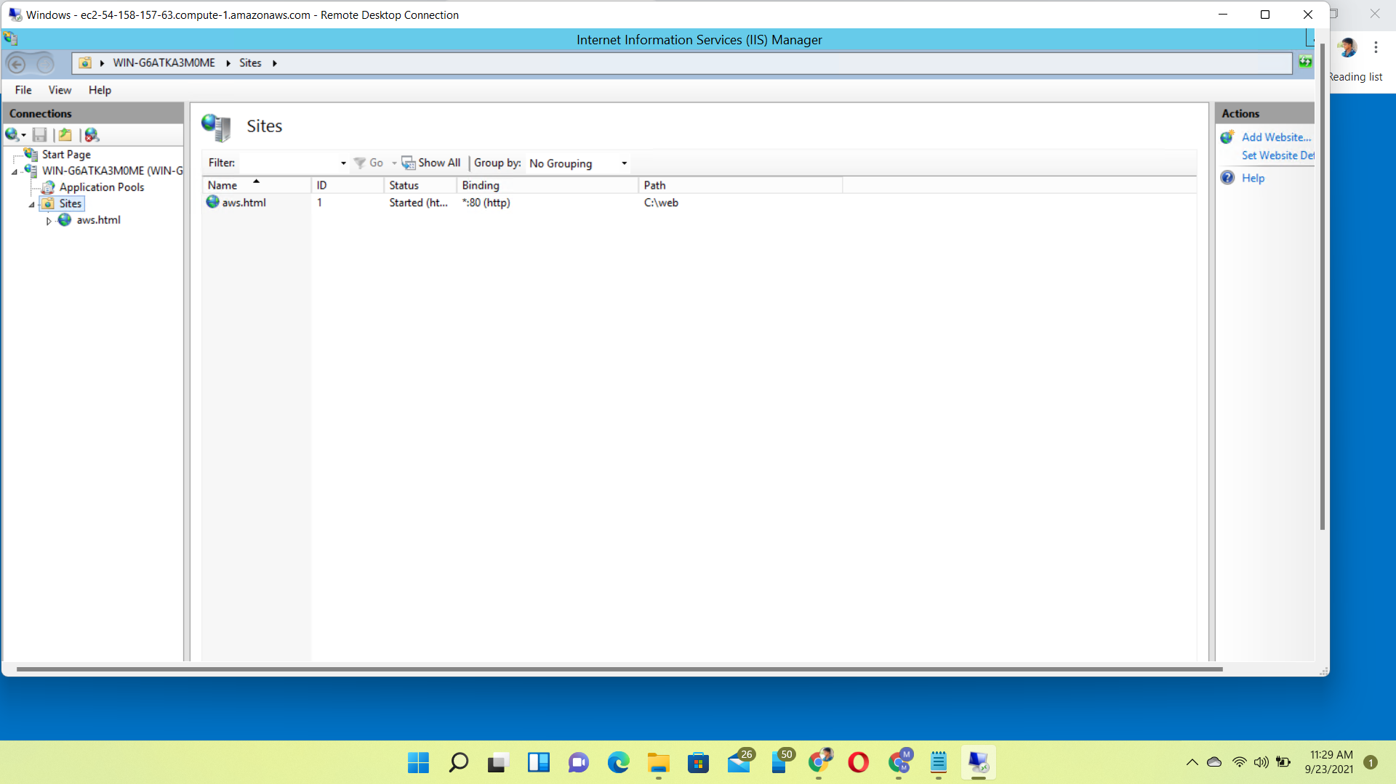
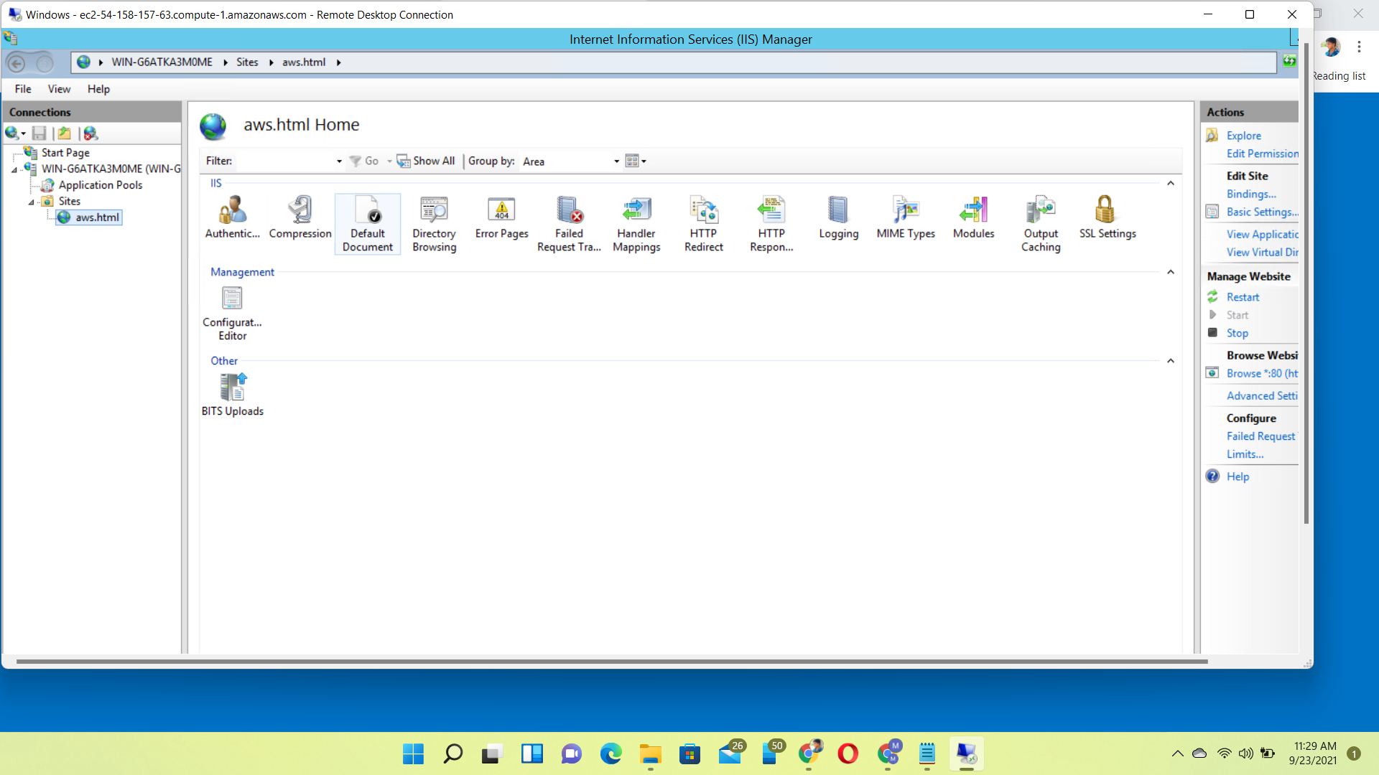
Add the website of our content page

Slide 16
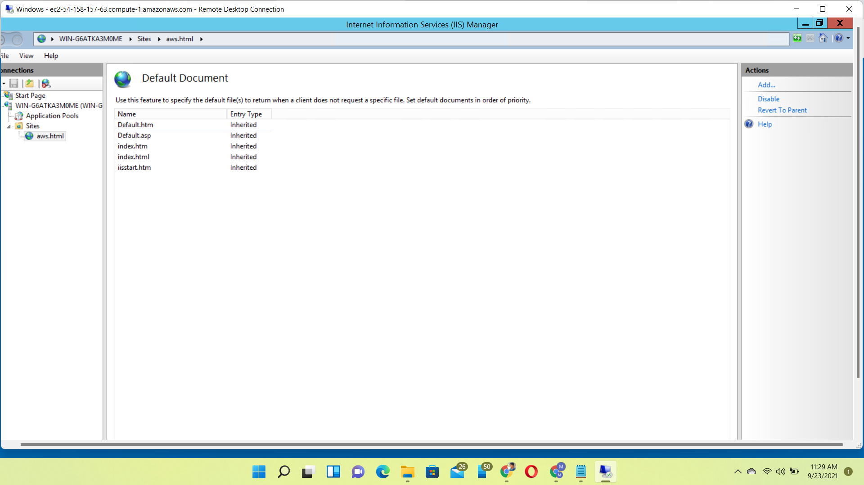
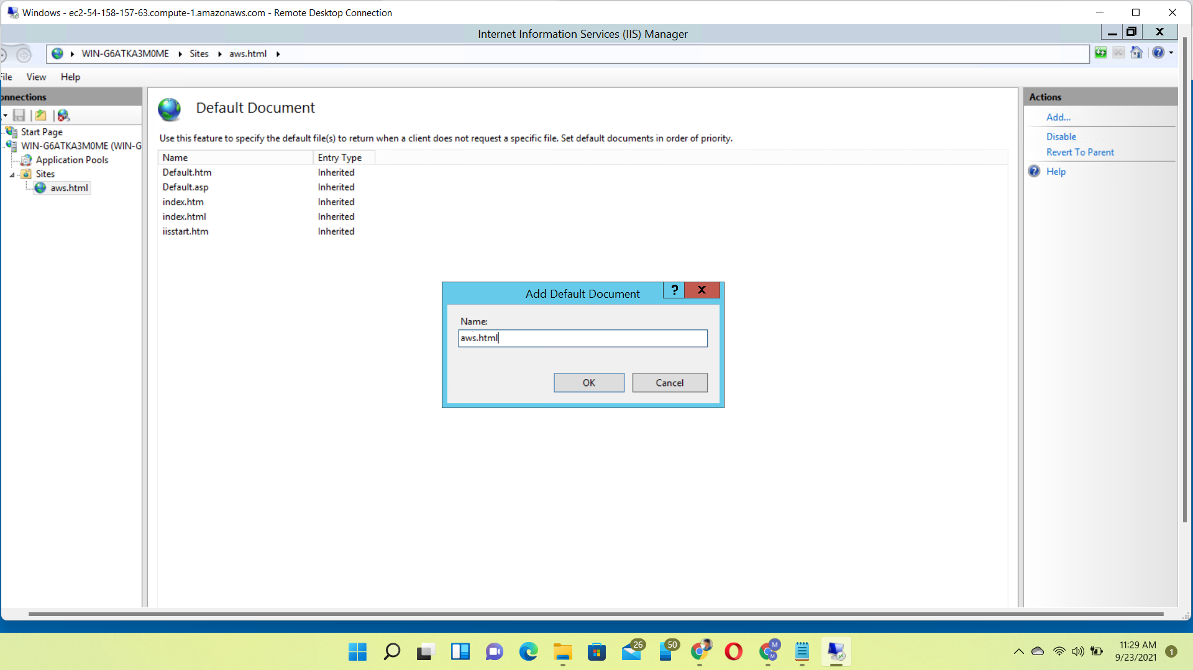
Click the aws.html file
fj

Slide 17
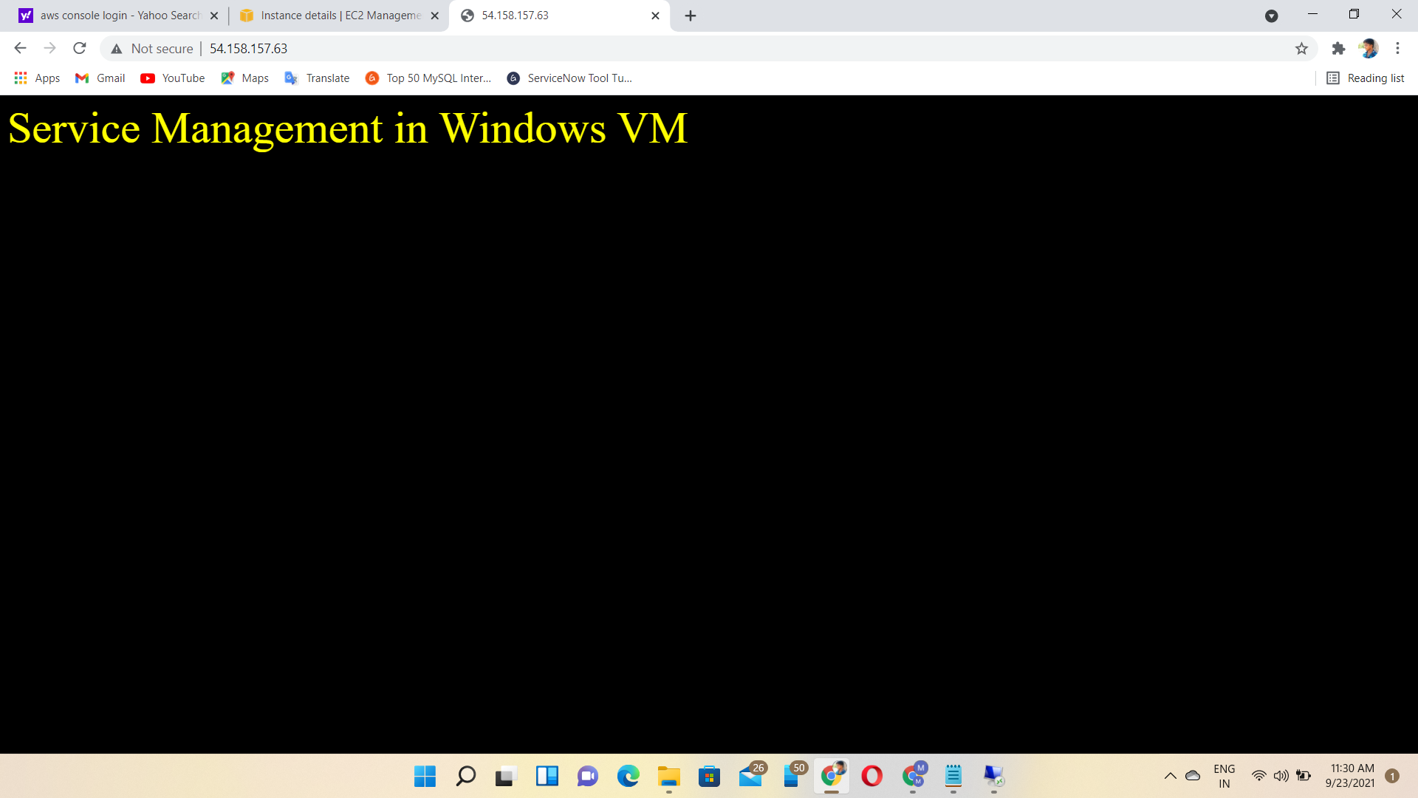
Output of the hosting our content page

Slide 18
thank you

